Slide 2
Table of Contents of Association 2015 Reunion Reports Treasurer, Webmaster and Membership Team Reports Prepared May 1, 2015
# |  | Document | Page #
1 | Treasurer’s Report |  | 2
 | 1. Financial Statements |  | 2
 | a. Statement of Financial Position as of December 31, 2014 |  |  | 6
 | b. Statement of Revenue & Expenses for Short Year |  |  | 7
 | 2. Activities & Accomplishments |  | 2
 | a. Banking Activities |  | 2
 | b. PayPal Activities |  | 2
 | c. Accounting Policies/Procedures & Internal Control |  | 3
 | 3. Cost Centers |  | 3
 | 4. Accounting System Software |  | 3
 | 5. Document Security Measurers/Daily Backups |  | 3
 | 6. Association Store |  | 4
 | 7. Revenue Generation Plan |  | 4
 | 8. Accounting Year |  | 5
 | 9. IRS Form 990-EZ |  | 5
 | 10. Conclusion |  | 5
2 | Webmaster’s Report |  | 8
 | 1. New Website |  | 8
 | 2. Website Capabilities |  | 8
 | 3. Membership Directory webpage (closed to Public viewing) |  | 8
 | 4. Sky Soldier Magazines webpage (closed to Public viewing) |  | 8
 | 5. Join Us webpage (open to Public viewing) |  | 9
 | 6. Association Documents webpage (open to Public viewing) |  | 9
 | 7. Other webpages (open to Public viewing) |  | 9
 | 8. Conclusion |  | 9
3 | Membership Team’s Report |  | 11
 | 1. New Website Software- Wild Apricot |  | 11
 | 2. Chart #1- Latest Membership List |  | 11
 | 3. Chart #2- Membership Matrix Table |  | 12
 | 4. Chart #3- Membership Payments |  | 13
 | 5. Membership Growth Plan |  | 13
 | 6. Communication Plan |  | 14
 | 7. Conclusion |  | 14
Page 2 of 14

Slide 3
STATE OF THE 173d AIRBORNE BRIGADE ASSOCIATION
Treasurer’s Report- as of May 1, 2015
TREASURER’S REPORT
Financial Statements
The Statement of Financial Position showing the Assets, Liabilities and Unrestricted Funds as of December 31, 2014 and compared to the prior year 2013
is shown on page 5 at the end of the report.
The Statement of Revenues and Expenses for the short year from June 1, 2014 to December 31, 2014 is shown on page 6 at the end of the report.
Because we are changing our accounting year from a Fiscal Year from June 1st to
May 31st to a Calendar Year from January 1st to December 31st, it is necessary to generate a report for the short year period.
Activities and Accomplishments
Banking Activities
Four checking accounts were consolidated into one Bank of America checking account which has branches nationwide so when National Officers change, it won’t be necessary to open new checking accounts. This helps reduce the number of financial transactions, transfer of funds among accounts and monthly bank reconciliations.
On-line banking was established to allow instant visual access by computer to view banking activities.
Set up ability to download all Bank of America checking account activities into the Association’s QuickBooks accounting software program.
Debit cards (in lieu of credit cards) were issued to the Association officers to use for Association business activities and to eliminate reimbursements.
Bank statements have been reconciled monthly.
iii.
PayPal Activities
A new PayPal account was opened for the 173d Foundation to eliminate
co-mingling of Association and Foundation funds generated from credit card transactions processed by PayPal. Again, this reduces the transfer of financial transaction in sorting out the transactions between the Association and Foundation.
Page 2 of 14

Slide 4
STATE OF THE 173d AIRBORNE BRIGADE ASSOCIATION
Treasurer’s Report- as of May 1, 2015
ii. Automatic, nightly sweeps into our Bank of America checking account was set up for any credit card payments processed by PayPal.
New links were created for Foundation Contributions directly into the Foundation’s new Bank of America checking account.
iv. PayPal transactions have been reconciled monthly to the Bank of America checking account as well as to the Association’s QuickBooks accounting software program.
iii.
c. Accounting Policies/Procedures and Internal Controls
Daily email alerts from Bank of America to the Association President and Association Treasurer were created to be sent for account transactions exceeding certain established limits.
Monthly Bank Statements are mailed to the Association President for
viewing and to the Association Treasure for monthly bank reconciliation. Written accounting policies and procedures were created as well as Check Request Forms and Debit Card Forms to identify what the expenditures are for; what Cost Center is to be charged; and requiring signed authorization and approval by an Association officer for internal control purposes to safeguard Association assets.
iii.
Cost Centers
Cost Centers were established for unique functions to evaluate Revenues and Expenses for:
Membership Fees and Expenses
Magazine Revenues and Expenses
Raffle Tickets Revenues and Expenses
Store Revenues and Expenses
Reunion Revenues and Expenses
General and Administrative Revenues and Expenses
Accounting System Software
The accounting software was upgraded to the 2014 QuickBooks Premier for Non-Profit Organizations.
Document Security Measures/Daily Backups
Page 3 of 14

Slide 5
STATE OF THE 173d AIRBORNE BRIGADE ASSOCIATION
Treasurer’s Report- as of May 1, 2015
Important documents have been stored in a free offsite cloud storage location so they may be retrieved and viewed when necessary by Association Officers. This is very important when officers are changed and records are physically moved to new locations. Examples of document categories are as follows:
Financial Reports
IRS Form 990-EZ’s
IRS Tax Exempt Letters
Corporate Documents
Articles of Incorporation
Corporate Name Change
By-Laws
5. Meeting Minutes
ii. Daily backups of all QuickBooks transactions were implemented to an offsite cloud location for security purposes.
New passwords were established for access to the Quickbooks accounting
information.
iii.
g. Association Store
A Catalog of the Association Store products has been published in the last two issues of Sky Soldier issues generating new revenues.
Recently, the Store Products have been published on our new Sky Soldier website and can be purchased by credit cards generating new revenues. An inventory was recently conducted of the store products and adjustments will be made accordingly.
A new Shopping Cart was added this week tour Store Catalog webpage providing more flexibility and customization of Store Products on our Association Store webpage.
In the near future, we will mark down and offer reduced prices for Store Inventory products that are not selling in order for better inventory control.
iii.
h. Revenue Generation Plan
Page 4 of 14

Slide 6
STATE OF THE 173d AIRBORNE BRIGADE ASSOCIATION
Treasurer’s Report- as of May 1, 2015
A Revenue Generation Plan was developed and presented to the Executive Board (National Officers and chapter Presidents) at the 2015 Mid-Winter Conference in January 2015 consisting of:
Membership Fees
Store Sales
Sky Soldier Magazine Ads
Commission Sales from website links to Vendor websites
Corporate Donations
Corporate Sponsors
Individual Donations
Accounting Year
Because Membership Dues are currently the major source of revenues, I
proposed a change in the Association Bylaws to change the accounting year from a fiscal year ending May 31st to a calendar year ending December 31st. The motion was approved at the 2015 Mid-Winter Conference in January 2015 and will voted on at the General Membership Meeting at the 2015 Reunion in San Diego, California.
IRS Form 990-EZ
Filed IRS Form 990 EZ fir the fiscal year ending May 31, 2014.
Filed IRS Form 1128 requesting change of accounting year from fiscal year ending May 31st to calendar year ending December 31st.
Conclusion
This report will be posted on our “About 173d Airborne Brigade Association” webpage https://www.skysoldier.net/About-173d-Airborne-Brigade-Association .
Jerry L. Cooper CPA
Treasurer and Webmaster
Page 5 of 14

Slide 7
8:01 AM
04/28/15
Accrual Basis
173d Airborne Brigade Association
Statement of Financial Position- Previous Year Comparison
As of December 31, 2014
Dec 31, 14 Dec 31, 13 $ Change
ASSETS
Current Assets Checking/Savings
% Change
1020 · Bank of America- Checking | 21,717.56 |  | 0.00 |  | 21,717.56 |  | 100.0%
1030 · Citizens Bank | 0.00 |  | 4,984.15 |  | -4,984.15 |  | -100.0%
1040 · Town Square Bank | 0.00 |  | 126.09 |  | -126.09 |  | -100.0%
1050 · WesBanco | 0.00 |  | 15,513.18 |  | -15,513.18 |  | -100.0%
1060 · PayPal | 0.00 |  | -3,890.31 |  | 3,890.31 |  | 100.0%
Total Checking/Savings | 21,717.56 |  | 16,733.11 |  | 4,984.45 |  | 29.8%
Accounts Receivable 1200 · Accounts Receivable | 0.00 |  | 200.00 |  | -200.00 |  | -100.0%
Total Accounts Receivable | 0.00 |  | 200.00 |  | -200.00 |  | -100.0%
Other Current Assets 1100 · Investments | 101,454.87 |  | 100,000.00 |  | 1,454.87 |  | 1.5%
1210 · Due From Foundation | 10,229.51 |  | 0.00 |  | 10,229.51 |  | 100.0%
1250 · Petty Cash-Store | 0.00 |  | 285.00 |  | -285.00 |  | -100.0%
1300 · Accrued Income | 0.00 |  | 5,048.50 |  | -5,048.50 |  | -100.0%
1550 · Postage Deposit-Gallaher | 0.00 |  | 500.00 |  | -500.00 |  | -100.0%
1600 · Inventory- Store | 48,201.34 |  | 43,327.80 |  | 4,873.54 |  | 11.3%
Total Other Current Assets | 159,885.72 |  | 149,161.30 |  | 10,724.42 |  | 7.2%
Total Current Assets | 181,603.28 |  | 166,094.41 |  | 15,508.87 |  | 9.3%
Fixed Assets 1800 · Equipment | 5,737.33 |  | 5,737.33 |  | 0.00 |  | 0.0%
1900 · Accumulated Depreciation | -1,922.19 |  | -673.30 |  | -1,248.89 |  | -185.5%
Total Fixed Assets | 3,815.14 |  | 5,064.03 |  | -1,248.89 |  | -24.7%
TOTAL ASSETS | 185,418.42 |  | 171,158.44 |  | 14,259.98 |  | 8.3%
LIABILITIES & EQUITY
Liabilities
Current Liabilities
Other Current Liabilities
2010 · Due To Foundation | -20.45 |  | -20,965.74 |  | 20,945.29 |  | 99.9%
2100 · Accrued Expenses | 0.00 |  | 4.45 |  | -4.45 |  | -100.0%
2300 · Accrued Dues Rebate | 27,462.65 |  | 14,381.00 |  | 13,081.65 |  | 91.0%
Total Other Current Liabilities | 27,442.20 |  | -6,580.29 |  | 34,022.49 |  | 517.0%
Total Current Liabilities | 27,442.20 |  | -6,580.29 |  | 34,022.49 |  | 517.0%
Long Term Liabilities 2500 · Deferred Dues | 72,216.17 |  | 77,557.51 |  | -5,341.34 |  | -6.9%
Total Long Term Liabilities | 72,216.17 |  | 77,557.51 |  | -5,341.34 |  | -6.9%
Total Liabilities | 99,658.37 |  | 70,977.22 |  | 28,681.15 |  | 40.4%
Equity 1110 · Retained Earnings | 94,824.18 |  | 173,319.15 |  | -78,494.97 |  | -45.3%
3000 · Opening Bal Equity | 0.00 |  | -43,668.79 |  | 43,668.79 |  | 100.0%
Net Income | -9,064.13 |  | -29,469.14 |  | 20,405.01 |  | 69.2%
Total Equity | 85,760.05 |  | 100,181.22 |  | -14,421.17 |  | -14.4%
TOTAL LIABILITIES & EQUITY | 185,418.42 |  | 171,158.44 |  | 14,259.98 |  | 8.3%
Page 7 of 14
Page 1

Slide 8
8:12 AM
04/28/15
Accrual Basis
173d Airborne Brigade Association
Statement of Financial Income and Expense- Short Year 2014
June through December 2014
TOTAL
Ordinary Income/Expense Income
4100 · Membership Dues | 19,877.55
4200 · Contributions Income | 687.00
4300 · Raffle | 288.03
4500 · Store Sales | 17,027.11
4700 · Miscellaneous Income | 841.31
Total Income | 38,721.00
Cost of Goods Sold 50000 · Cost of Goods Sold | 1,384.00
5100 · Purchases | 1,500.00
Total COGS | 2,884.00
Gross Profit | 35,837.00
Expense 6120 · Bank Charges | 117.00
6125 · Bereavement Expense | 174.00
6135 · Chapter Rebates | 4,220.00
6140 · Computer software | 519.88
6153 · Credit Card Charges | 241.59
6155 · Data Base Expenses | 9.95
6190 · Magazine Expenses | 15,651.92
6195 · Office Expense | 1,571.66
6198 · PayPal Expenses | 99.15
6200 · Postage & Shipping | 2,899.09
6210 · Printing & Repro | 305.44
6220 · Professional Fees | 1,849.00
6230 · QuickBooks Backup Expense | 30.17
6240 · Raffle Ticket Expense | 1,200.00
6250 · Rent | 600.00
6253 · Supplies | 1,568.69
6280 · Travel | 11,023.83
6290 · Tributes | 485.00
6300 · Website Expenses | 2,630.50
6800 · Uncategorized | -295.74
Total Expense | 44,901.13
Net Ordinary Income | -9,064.13
Net Income | -9,064.13
Page 8 of 14
Page 1

Slide 9
STATE OF THE 173d AIRBORNE BRIGADE ASSOCIATION
Webmaster’s Report- as of May 1, 2015
WEBMASTER’S REPORT
New Website
A new Sky Soldier website was created using a website program Wild Apricot.
The website domain name www.skysoldier.net was retained.
The similar webpages from the old website were loaded to the new website along with many other features.
Security measures were implemented and website certification implemented.
The creation and maintenance costs have been offset by new membership dues and store sales generated with the new website.
Website Capabilities
Membership Management capabilities
Event Management capabilities
Contribution Reporting capabilities
Mass Emailing capabilities
Financial Reporting capabilities
Membership Directory (closed to public viewing)
Available only to members holding life time memberships or annual members who are current on their annual dues.
b. Gives active members the ability to search for active members using various
search attributes (state of residence, chapter affiliation, zip cost, Vietnam unit, etc.)
Sky Soldier Magazines Webpage (closed to public viewing)
The ability to view the current as well as 104 past issues of our Sky Soldier magazines was created.
Only members holding life time memberships or annual members who are current
on their annual dues will be able to view the magazines on line as well as receiving mailed hard copies.
Members are encouraged to switch from receiving mailed copies to viewing online to save $7.75 annually per member.
All of the digitized magazine have been stored in an offsite cloud storage site for security purposes and to avoid taking up space on the webmaster’s computer.
Page 8 of 14

Slide 10
STATE OF THE 173d AIRBORNE BRIGADE ASSOCIATION
Webmaster’s Report- as of May 1, 2015
Join Us Webpage (available for public viewing)
A new webpage with the ability to join the Association as well as pay annual membership dues by credit card was established.
Association Documents (available for public viewing)
The following categories with their respective documents have been loaded to the new website:
Corporation Documents (Articles of Incorporation, By-Laws, etc.)
IRS Reports (IRS Tax Exemption Letter, Form 990-EZ’s. etc.)
Financial Reports
Meeting Minutes
Other Webpages (available for public viewing)
About Us
National Officers
Chapter Contacts
Donations
History
Scheduled Events
Store Catalog
Annual Reunions
Chapter Newsletters
Scholarship Program
Yearbooks
Foundation
Memorial
Active Brigade
KIA’s
Links
Bulletin Board (under construction)
Blogs (under construction)
Conclusion
Page 9 of 14

Slide 11
STATE OF THE 173d AIRBORNE BRIGADE ASSOCIATION
Webmaster’s Report- as of May 1, 2015
a. This report will be posted on our “About 173d Airborne Brigade Association” webpage https://www.skysoldier.net/About-173d-Airborne-Brigade-Association .
Jerry L. Cooper CPA
Treasurer and Webmaster
b.
Page 10 of 14

Slide 12
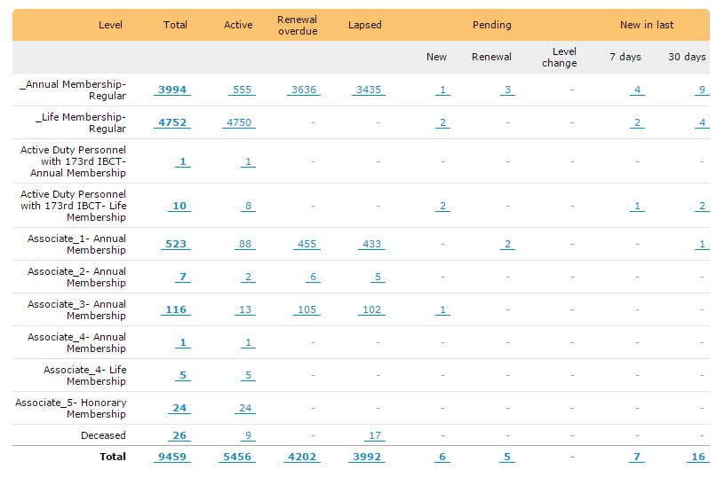
STATE OF THE 173d AIRBORNE BRIGADE ASSOCIATION
Membership Team’s Report- as of May 1, 2015
MEMBERSHIP TEAM’S REPORT
Our new Website software Wild Apricot has a Membership Database component which gives us multiple capabilities. Because this database has been created over a 15 year period, there are many, many errors, omissions, etc., that our Membership Team comprised of Membership Secretary Dennis Hill and my Website Assistant Peter Klausner are tasked with and they are diligently laboring to bring our Membership database up to date. This is a huge task, but they are performing exceptionally well! I think the best way to convey our current Membership status is by displaying several different Charts.
CHART #1- Latest Membership List
The first Chart dated April 26, 2015 shows the 9,459 Members of the Association broken down by Membership Levels, which are further broken down between Active and Lapsed. We have 5,456 Active Members whose annual dues are current or hold Life Memberships. We have 3,992 Lapsed Members who are not current on their Membership Dues, and in some cases are deceased. We are in the process of updating those records.
Page 11 of 14

Slide 13
STATE OF THE 173d AIRBORNE BRIGADE ASSOCIATION
Membership Team’s Report- as of May 1, 2015
CHART #2- Membership Matrix Table
The second Chart displays the changes in Membership Levels since 8/2/2014 Membership Database was created using the Wild Apricot software until recently.
when the
Active Membership only | # Change Since | % Change Since | Count As of | Count As of
 | 8/2/2014 | 8/2/2014 | 4/26/2015 | 8/2/2014
Annual Membership- Regular | 87 | 19% | 555 | 468
Life Membership - Regular | 258 | 6% | 4750 | 4492
Active Duty173rd IBCT Personnel- Annual Membership | 1 | 0.00% | 1 | 0
Active Duty173rd IBCT Personnel- Life Membership | 8 | 500% | 8 | 0
Associate 1- Annual Membership | 15 | 21% | 88 | 73
Associate 2- Annual Membership | 0 | 0% | 2 | 2
Associate 3- Annual Membership | -3 | -19% | 13 | 16
Associate 4- Annual Membership | 1 | 0% | 1 | 0
Associate 4- Life Membership | 3 | 150% | 5 | 2
Associate 5- Honorary Membership | 24 | 0% | 24 | 0
Deceased | 9 | 0% | 9 | 0
Totals | 403 | 8% | 5456 | 5053
Chart #3- Membership Payments
The third Chart displays the payment of Membership Dues, Donations, Event Registrations, etc. on our new website using the Wild Apricot software. In this Chart, you can see how effective the ability to pay by credit card on our new website has been since being implemented in October 2014. Over 85% of our Membership payments have been by Members using their credit cards on our website and processed through PayPal. This greatly reduces manual processing of Membership payments and accelerates deposits with nightly sweeps from PayPal collections into the
Page 12 of 14

Slide 14
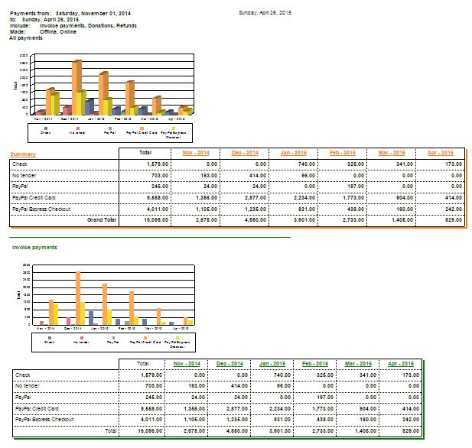
STATE OF THE 173d AIRBORNE BRIGADE ASSOCIATION
Membership Team’s Report- as of May 1, 2015
Association’s checking account. This process also provides detailed reports and as well as tracking for transparency purposes.
As reflected in the below chart, we have received over $16,607.00 in Membership payments since November 1, 2014.
Membership Growth Plan/Communication Plan
At our 2015 Mid-Winter Conference, I recommended to the Board of Directors in attendance that in order for the Association to increase Membership, we need to develop and implement the following plans:
1. Membership Growth Plan
Page 13 of 14

Slide 15
STATE OF THE 173d AIRBORNE BRIGADE ASSOCIATION
Membership Team’s Report- as of May 1, 2015
Recruit new Members from:
Former Sky Soldiers who served on active duty and
Current Sky Soldiers who are currently serving on active duty
Retain current Members
Re-enlist former Members whose Memberships have lapsed
Communication Plan
Communication Approaches by Priority
Sky Soldier Website
Mass Emails
Sky Soldier Quarterly Magazines
Newspaper/Radio Public Information Announcements
To achieve these goals, it is my belief that we need a volunteer to implement the Membership Growth Plan and a separate volunteer to accept the role of the Association’s Public Information officer to promote our Association thru various public media and social media sources.
Members who are interested in these assuming these positions should email our Association President Roy F. Scott Jr. at president@skysoldier.net and indicate the position they are interested in along with an outline of their plan to accomplish these goals for that respective objective.
Conclusion
Before closing, I again want to thank our Membership Team of Dennis Hill and Peter Klausner who have made this possible. They do a tremendous job and devote numerous hours this very important project. Dennis inputs all new membership information to our Membership database and Peter prepares and send welcome letters with membership cards. They have been doing this for years behind the scenes and their dedication and hard work often go un-noticed. So the next time you see them, hug them and thank them for their devotion!
This report will be posted on our “About 173d Airborne Brigade Association” webpage https://www.skysoldier.net/About-173d-Airborne-Brigade-Association .
Jerry L. Cooper CPA
Membership Team Leader, Treasurer and Webmaster
Page 14 of 14

